Slide 1
2022 Summer Internship at IU Health
Data Science

Slide 2
About me
Master’s student majoring in Applied Data Science at IUPUI
Bachelor’s in Information Technology from CEG, Anna University, Chennai
Internship team at IU Health : Enterprise Analytics, Clinical Research Department
Random fact about me : I enjoy making Indian Kerala Mural Paintings and have been trained in Indian Classical Music for several years

Slide 3
Purpose:
Group patients / drugs into different cohorts according to diseases and drugs to derive insightful information
In order to do so, understand the nomenclature of drugs and understand the different naming systems of drugs

Slide 4
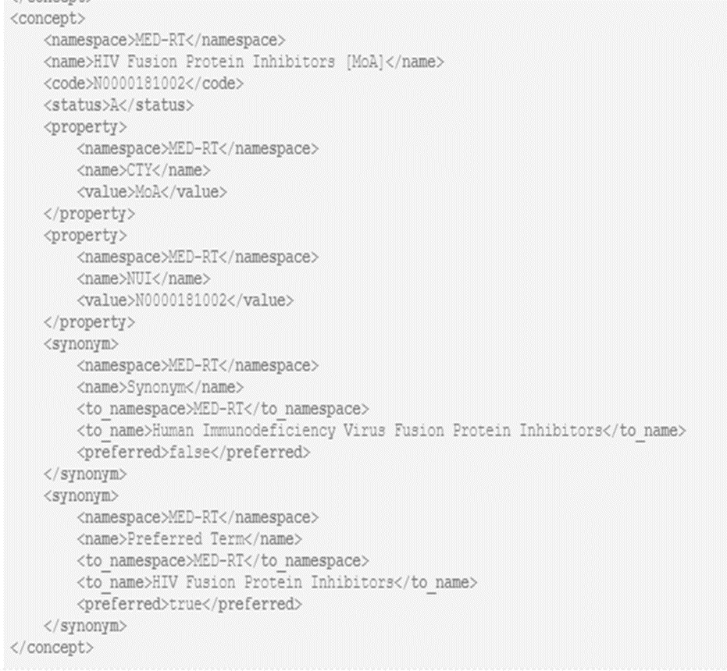
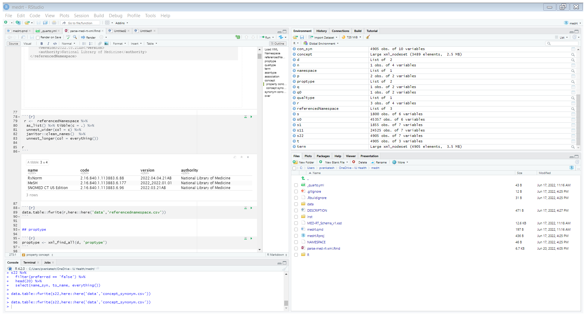
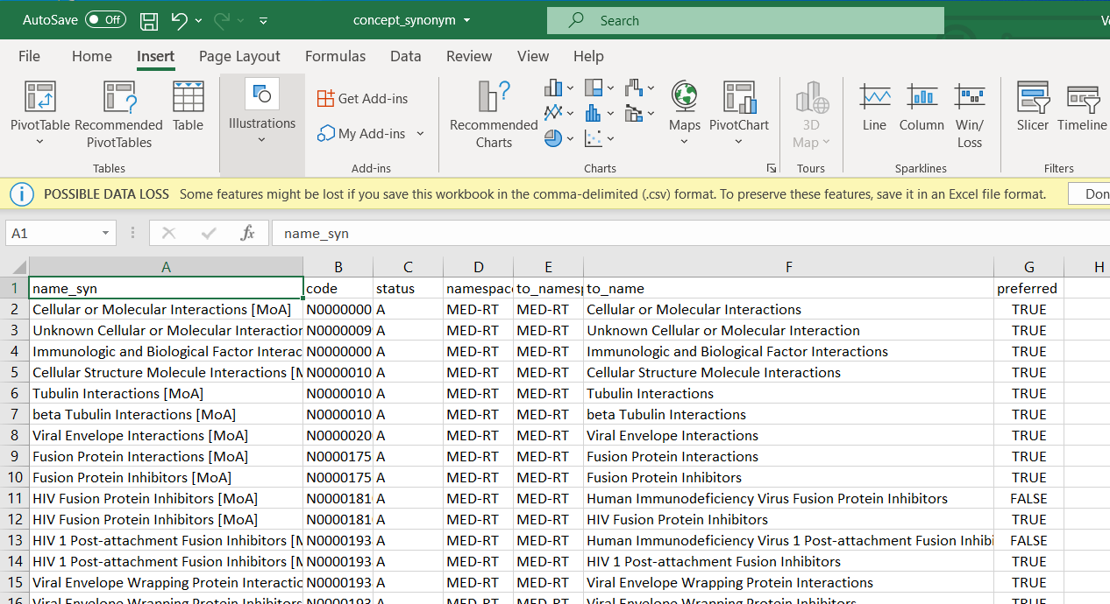
Transform complex xml files to 2 dimensional data with rows and columns

Slide 5
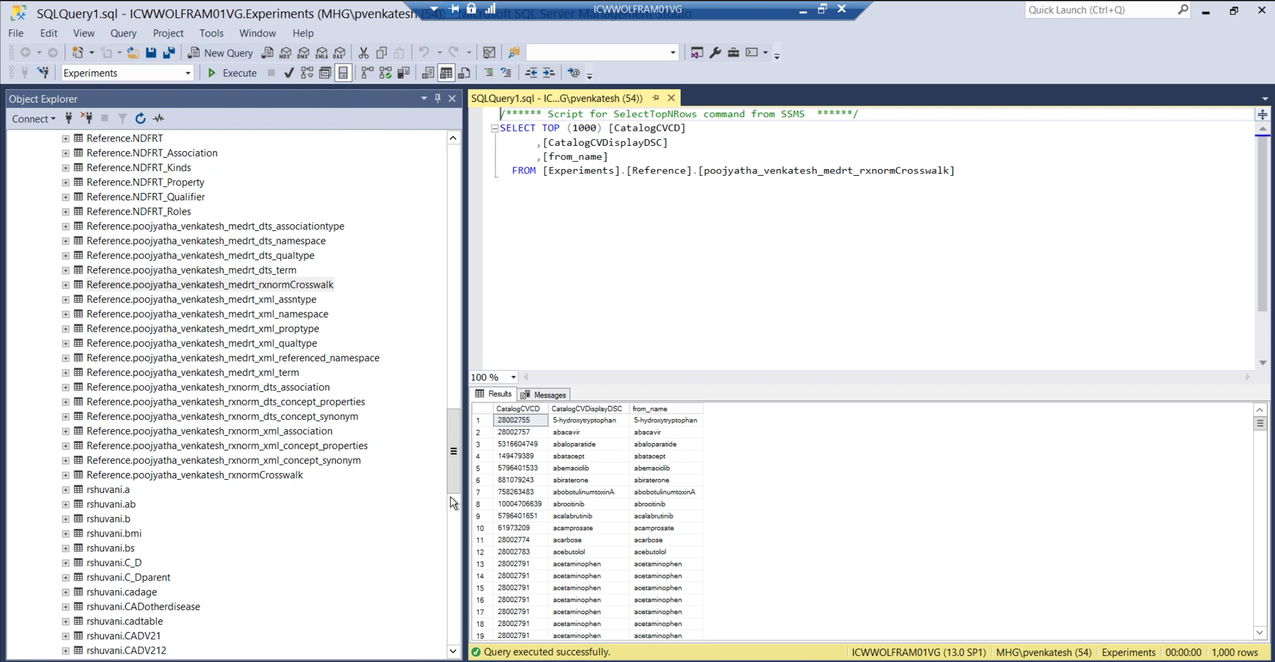
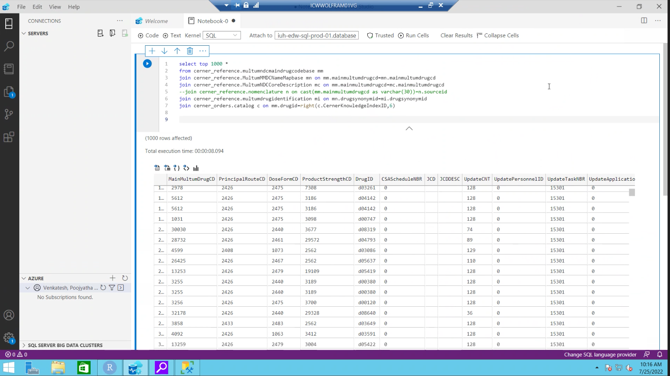
Uploaded created files to Microsoft SQL Server Accessed data from the Cerner

Slide 6
Formed crosswalks between data from Wolfram as well as Cerner

Slide 7
Grouped drugs and patients using SQL

Slide 8
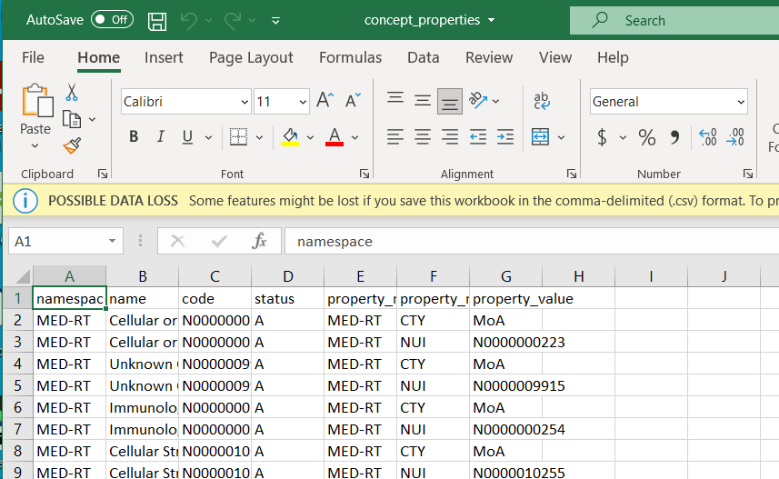
How we resolved the issue :
Properties tag from concept
Synonym tag from concept

Slide 9
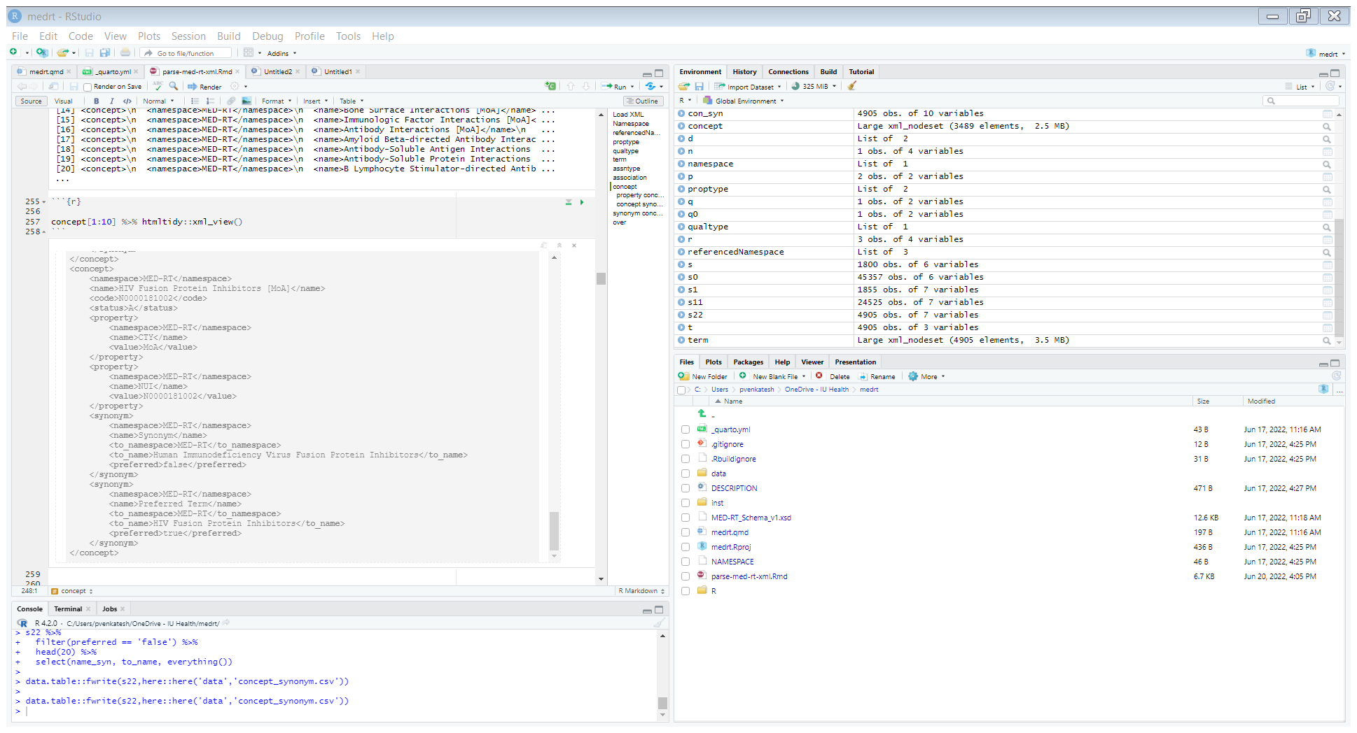
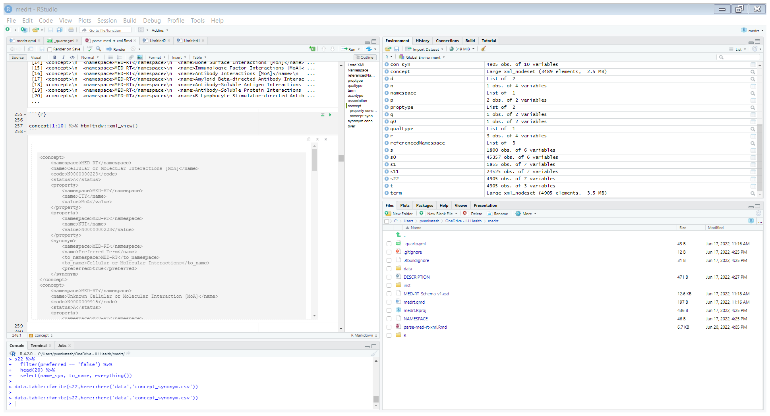
Challenges – when two same tags had different structures, deciding the entity formats were hard

